Slide 1

Principles of
Operating System
Process Synchronization

Slide 2


Roadmap
Background
The Critical-Section Problem
Synchronization Hardware
Semaphores
Classical Problems of Synchronization
Critical Regions

Slide 3
Background
Concurrent access to shared data may result in data inconsistency.
Maintaining data consistency requires mechanisms to ensure the orderly execution of cooperating processes.

Slide 4
Background (cont.)
Shared-memory solution to bounded-buffer problem allows at most buffer_size – 1 items in buffer at the same time.
A solution, where all buffer_size buffers are used is not simple.
  Suppose that we modify the producer-consumer code by adding a variable counter, initialized to 0 and incremented each time a new item is added to the buffer

Slide 5
Bounded-Buffer
Shared data
      #define BUFFER_SIZE 10
      typedef struct {
      . . .
      } item;
      item buffer[BUFFER_SIZE];
      int in = 0;
      int out = 0;
      int counter = 0;

Slide 6
Implementation of Insert() Method
Producer process
item nextProduced;
while (1) {
while (counter == BUFFER_SIZE)
; /* do nothing */
buffer[in] = nextProduced;
in = (in + 1) % BUFFER_SIZE;
counter++;
}

Slide 7
Implementation of Remove() Method
Consumer process
item nextConsumed;
while (1) {
while (counter == 0)
; /* do nothing */
nextConsumed = buffer[out];
out = (out + 1) % BUFFER_SIZE;
counter - - ;
}

Slide 8
Issues of Bounded Buffer
The statement “count++” may be implemented in machine language as:
register₁ = counter
register₁ = register₁ + 1
counter = register₁
The statement “count - -” may be implemented as:
register₂ = counter
register₂ = register₂ – 1
counter = register₂

Slide 9
Issues of Bounded Buffer (cont.)
Assume counter is initially 5. One interleaving of statements is:
The value of counter may be either 4 or 6, where the correct result should be 5.
producer: register₁ = counter (register₁ = 5)
producer: register₁ = register₁ + 1 (register₁ = 6)
consumer: register₂ = counter (register₂ = 5)
consumer: register₂ = register₂ – 1 (register₂ = 4)
producer: counter = register₁ (counter = 6)
consumer: counter = register₂ (counter = 4)
Race condition

Slide 10
Race Condition
Race condition
  The situation where several processes access and manipulate shared data concurrently.
  The final value of the shared data depends upon which process finishes last.
To prevent race conditions, concurrent processes must be synchronized.

Slide 11
Roadmap
Background
The Critical-Section Problem
Synchronization Hardware
Semaphores
Classical Problems of Synchronization
Critical Regions

Slide 12
The Critical-Section Problem
Background
  n processes all competing to use some shared data
  Each process has a code segment, called critical section, in which the shared data is accessed.
Problem
  ensure that when one process is executing in its critical section, no other process is allowed to execute in its critical section.

Slide 13
Solution to Critical-Section Problem
1. Mutual Exclusion
2. Progress
3. Bounded Waiting
  If P_{i} is executing in its critical section, then no other processes can be executing in their critical sections.
  A bound must exist on the number of times that other processes are allowed to enter their critical sections after a process has made a request to enter its critical section and before that request is granted.
    Assume that each process executes at a nonzero speed
    No assumption concerning relative speed of the n processes.
  If no process is executing in its critical section and there exist some processes that wish to enter their critical section, then the selection of the processes that will enter the critical section next cannot be postponed indefinitely.

Slide 14
Initial Attempts to Solve Problem
Only 2 processes, P₀ and P₁, general structure of process P_{i} (other process P_{j})
do {
entry section
critical section
exit section
reminder section
} while (1);
Processes may share some common variables to synchronize their actions.

Slide 15
The Critical-Section Problem: 2-Processes: Algorithm 1
Shared variables:
  int turn; // initially turn = 0
  turn = i; // P_{i} can enter its critical section
Process P_{i}
do {
while (turn != i) ;
critical section
turn = j;
reminder section
} while (1);
Satisfies mutual exclusion, but not progress.

Slide 16
The Critical-Section Problem: 2-Processes: Algorithm 2
Shared variables
  boolean flag[2]; // initially flag[0] = flag[1] = false.
  flag [i] = true; // Action: P_{i} will enter its critical section intention
Process P_{i}
do {
flag[i] = true;
while (flag[j]) ;
critical section
flag [i] = false;
remainder section
} while (1);
Satisfies mutual exclusion, but not progress.

Slide 17
Peterson’s Solution
Two process solution
  Assume that the LOAD and STORE instructions are atomic, i.e. cannot be interrupted.
The two processes share two variables:
  int turn;
    The variable turn indicates whose turn it is to enter the critical section.
  boolean flag[2];
    The flag array is used to indicate if a process is ready to enter the critical section. flag[i] = true implies that process P_{i} is ready!

Slide 18
Algorithm for Process P_{i}
do {
flag [i]:= true;
turn = j;
while (flag [j] and turn == j) ;
critical section
flag [i] = false;
remainder section
} while (1);

Slide 19
Roadmap
Background
The Critical-Section Problem
Synchronization Hardware
Semaphores
Classical Problems of Synchronization
Critical Regions

Slide 20
Synchronization Hardware
Many systems provide hardware support for critical section code
Uniprocessors – could disable interrupts
  Currently running code would execute without preemption
  Generally too inefficient on multiprocessor systems
Modern machines provide special atomic hardware instructions
  Either test memory word and set value
  Or swap contents of two memory words

Slide 21
TestAndSet Instruction
Definition:
boolean TestAndSet (boolean *target){
boolean rv = *target;
*target = TRUE;
return rv:
}
Test and modify the content of a word atomically

Slide 22
Solution using TestAndSet
Shared boolean variable lock., initialized to false.
Solution:
while (true) {
while ( TestAndSet (&lock )) ; // do nothing
// critical section
lock = FALSE;
// remainder section
}

Slide 23
Swap Instruction
Definition:
void Swap (boolean *a, boolean *b){
boolean temp = *a;
*a = *b;
*b = temp:
}

Slide 24
Solution using Swap
Shared Boolean variable lock initialized to FALSE; Each process has a local Boolean variable key.
Solution:
while (true) {
key = TRUE;
while ( key == TRUE)
Swap (&lock, &key );
// critical section
lock = FALSE;
// remainder section
}

Slide 25
Roadmap
Background
The Critical-Section Problem
Synchronization Hardware
Semaphores
Classical Problems of Synchronization
Critical Regions

Slide 26
Semaphores
Semaphore S – integer variable, can only be accessed via two indivisible (atomic) operations
  Originally called P() and V()
wait (S):
while S≤ 0 do
; // no-op
S--;
signal (S):
S++;

Slide 27
Critical Section of n Processes
Shared data:
semaphore mutex; // initially mutex = 1
Process Pi:
do {
wait(mutex);
critical section
signal(mutex);
remainder section
} while (1);

Slide 28
Mutex-exclusion Implementation with semaphores
Consider two concurrently running processes:
  P₁ with a statement S₁ and P₂ with a statement S₂.
  S₂ must be executed only after S₁ has completed.
Solution
  Let P₁ and P₂ share a common semaphore synch, initialized to 0
P₁:
S₁;
signal(synch);
P₂:
wait(synch);
S₂;

Slide 29
Semaphore Implementation
Define a semaphore as:
typedef struct {
int value;
struct process *L;
} semaphore;
Assume two simple operations:
  block suspends the process that invokes it.
  wakeup(P) resumes the execution of a blocked process P.

Slide 30
Implementation
Semaphore operations now defined as
wait(S):
S.value--;
if (S.value < 0) {
add this process to S.L;
block();
}
signal(S):
S.value++;
if (S.value <= 0) {
remove a process P from S.L;
wakeup(P);
}

Slide 31
Deadlock and Starvation
Deadlock – two or more processes are waiting indefinitely for an event that can be caused by only one of the waiting processes.
Let S and Q be two semaphores initialized to 1
P₀ P₁
wait(S); wait(Q);
wait(Q); wait(S);
 
signal(S); signal(Q);
signal(Q) signal(S);
Starvation – indefinite blocking. A process may never be removed from the semaphore queue in which it is suspended.

Slide 32
Two Types of Semaphores
Counting semaphore – integer value can range over an unrestricted domain.
Binary semaphore – integer value can range only between 0 and 1; can be simpler to implement.
Can implement a counting semaphore S as a binary semaphore.

Slide 33
Roadmap
Background
The Critical-Section Problem
Synchronization Hardware
Semaphores
Classical Problems of Synchronization
Critical Regions

Slide 34
Classical Problems of Synchronization
Bounded-Buffer Problem
Readers and Writers Problem
Dining-Philosophers Problem

Slide 35
Bounded-Buffer Problem
N buffers, each can hold one item
Semaphore mutex
  initialized to the value 1
Semaphore full
  initialized to the value 0
Semaphore empty
  initialized to the value N.

Slide 36
Bounded Buffer Problem (Cont.)
The structure of the producer process
while (true) {
// produce an item
wait (empty);
wait (mutex);
// add the item to the buffer
signal (mutex);
signal (full);
}

Slide 37
Bounded Buffer Problem (Cont.)
The structure of the consumer process
while (true) {
wait (full);
wait (mutex);
// remove an item from buffer
signal (mutex);
signal (empty);
// consume the removed item
}

Slide 38
Readers-Writers Problem
A data set is shared among a number of concurrent processes
  Readers : only read the data set; they do not perform any updates
  Writers : can both read and write.
Problem
  allow multiple readers to read at the same time.
  only one single writer can access the shared data at the same time.

Slide 39
Readers-Writers Problem (cont.)
Solution: writers have exclusive access to the shared object.
Shared Data
  Data set
  Semaphore mutex : initialized to 1, used to ensure mutual exclusion when the variable readcount is updated.
  Semaphore wrt : initialized to 1, common to both the reader and writer processes, used as a mutual exclusion semaphore for the writer.
  Integer readcount : initialized to 0, keeps track of how many processes are reading the object.

Slide 40
Readers-Writers Problem (Cont.)
The structure of a writer process
while (true) {
wait (wrt) ;
// writing is performed
signal (wrt) ;
}

Slide 41
Readers-Writers Problem (Cont.)
The structure of a reader process
while (true) {
wait (mutex) ;
readcount ++ ;
if (readcount == 1) wait (wrt) ;
signal (mutex)
// reading is performed
wait (mutex) ;
readcount - - ;
if (readcount == 0) signal (wrt) ;
signal (mutex) ;
}

Slide 42
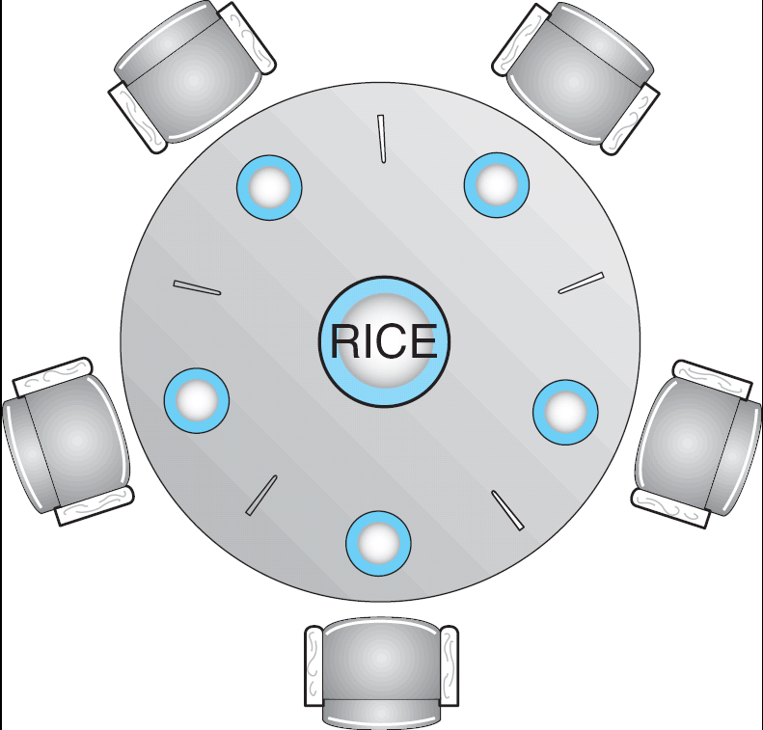
Dining-Philosophers Problem
Shared data
semaphore chopstick[5];
Initially all values are 1

Slide 43
Dining-Philosophers Problem
Philosopher i:
do {
wait(chopstick[i])
wait(chopstick[(i+1) % 5])
…
eat
…
signal(chopstick[i]);
signal(chopstick[(i+1) % 5]);
…
think
…
} while (1);

Slide 44
Roadmap
Background
The Critical-Section Problem
Synchronization Hardware
Semaphores
Classical Problems of Synchronization
Critical Regions
Monitors

Slide 45
Why Critical Regions?
Given that we have semaphores, why do we need another programming language feature for dealing with concurrency?
• Semaphores are low-level.
• Omitting a wait breaches safety — we can end up with more than one process inside a critical section.
• Omitting a signal can lead to deadlock.
• Semaphore code is distributed throughout a program, which causes maintenance problems.
• Better to use a high-level construct/abstraction.

Slide 46
Problems with Semaphores
Correct use of semaphore operations:
  signal (mutex) …. wait (mutex)
  wait (mutex) … wait (mutex)
  Omitting of wait (mutex) or signal (mutex) (or both)
Violating the mutual exclusion requirement.
Deadlock will occur.
Either mutual exclusion is violated or a deadlock will occur.

Slide 47
Critical Regions
High-level synchronization construct
Assumption
  A process consists of some local data, and a sequential program that can operate on the data.
  The local data can be accessed by only the sequential program that is encapsulated within the same process.
  Process can share global data.

Slide 48
Critical Regions (cont.)
A shared variable v of type T, is declared as:
v: shared T
Variable v accessed only inside statement
region v when (B) S
  where B is a boolean expression.
  While statement S is being executed, no other process can access variable v.

Slide 49
E.g. Producer-Consumer Problem
Shared data:
struct buffer {
int pool[n];
int count, in, out;
}

Slide 50
Bounded Buffer Producer Process
Producer process inserts nextp into the shared buffer
region buffer when( count < n) {
pool[in] = nextp;
in:= (in+1) % n;
count++;
}

Slide 51
Bounded Buffer Consumer Process
Consumer process removes an item from the shared buffer and puts it in nextc
region buffer when (count > 0) { nextc = pool[out];
out = (out+1) % n;
count--;
}

Slide 52
Roadmap
Background
The Critical-Section Problem
Synchronization Hardware
Semaphores
Classical Problems of Synchronization
Critical Regions
Monitors

Slide 53
MONITORS From Wikipedia
In concurrent programming, a monitor is an object intended to be used safely by more than one thread. The defining characteristic of a monitor is that its methods are executed with mutual exclusion. That is, at each point in time, at most one thread may be executing any of its methods. This mutual exclusion greatly simplifies reasoning about the implementation of monitors compared with code that may be executed in parallel.
Monitors also provide a mechanism for threads to temporarily give up exclusive access, in order to wait for some condition to be met, before regaining exclusive access and resuming their task. Monitors also have a mechanism for signaling other threads that such conditions have been met.
Monitors were invented by C.A.R. Hoare and Per Brinch Hansen, and were first implemented in Brinch Hansen's Concurrent Pascal language.

Slide 54
MONITORS
High-level synchronization construct that allows the safe sharing of an abstract data type among concurrent processes.
The monitor construct ensures that only one process at a time can be active within the monitor. (mutual exclusion)
To synchronize processes, conditional variables are required.
monitor monitor-name
{ shared variable declarations
procedure body P1 (…) { . . . }
procedure body P2 (…) { . . . }
procedure body Pn (…) { . . . }
{ initialization code }
}

Slide 55

Monitor: Schematic View

Slide 56
Monitors
The original proposals by C.A.R. Hoare and Per Brinch Hansen were for blocking condition variables. Monitors using blocking condition variables are often called Hoare style monitors. With a blocking condition variable, the signaling thread must wait outside the monitor (at least) until the signaled thread relinquishes occupancy of the monitor by either returning or by again waiting on a condition.

Slide 57
Monitors
To allow a process to wait within the monitor, a condition variable must be declared, as
condition x, y;
Condition variable can only be used with the operations wait and signal.
  The operation
  x.wait();
  means that the process invoking this operation is suspended until another process invokes
  x.signal();
  The x.signal operation resumes exactly one suspended process. If no process is suspended, then the signal operation has no effect.

Slide 58

Monitor: With Condition Variables

Slide 59
Keystone
The critical-section problem and solution
Semaphores and the atomic operations (wait and signal)
The bounded-buffer problem and solution
The readers-writers problem and solution
The dining-philosophers problem and solution

Slide 60
Homework
The Sleeping-Barber Problem:
  A barbershop consists of a waiting room with n chairs and the barber room containing the barber chair.
  If there are no customers to be served, the barber goes to sleep.
  If a customer enters the barbershop and all chairs are occupied, then the customer leaves the shop.
  If the barber is busy but chairs are available, then the customer sits in one of the free chairs.
  If the barber is asleep, the customer wakes up the barber.
Write a program to coordinate the barber and the customers.

Slide 61
Homework
The Cigarette-Smokers Problem.
  Consider a system with three smoker processes and one agent process.
  Each smoker continuously rolls a cigarette and then smokes it. But to roll and smoke a cigarette, the smoker needs three ingredients: tobacco, paper, and matches. One of the smoker processes has paper, another has tobacco, and the third has matches.
  The agent has an infinite supply of all three materials. The agent places two of the ingredients on the table. The smoker who has the remaining ingredient then makes and smokes a cigarette, signaling the agent on completion. The agent then puts out another two of the three ingredients, and the cycle repeats.
Write a program to synchronize the agent and the smokers.

Slide 62
Principles of
Operating System
End of Process Synchronization

